Slide 1
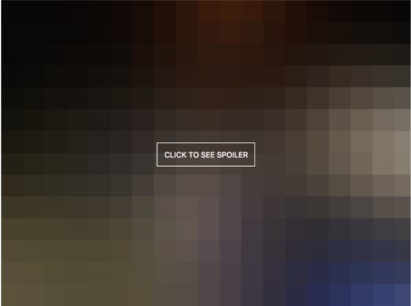

Slide 2

Detecting Movie Spoilers
Brian tracy

Slide 3

Background
Information that reveals important plot details or surprises
Reviews influence consumer attitude and decisions on seeing a movie
Users will avoid resources that present them with spoilers
Notes:
Studies show that anticipation and suspension of disbelief are key ingredients to a pleasurable experience, and spoilers ruin both
Spoiler can be explicit, i.e. revealing detail or implicit, something like ‘you won’t believe the twist ending’
Statista data shows about 2/3 of adults use movie read movie reviews
Some sites specialize in movie spoilers (themoviespoiler.com) if users want to seek them out

Slide 4

Business Problem
Current model relies on site moderation and user reporting
Automated flagging systems can free resources for other problems
Goal: increase user confidence they will not be presented with spoilers
Notes:
IMDB does moderate their site but mostly relies on the users flagging their reviews themselves or reporting other reviews
By employing automated flagging systems to hide user reviews IMDB can free resources for other user experience issues
The goal being that users can be confident they can read reviews on the site without being presented with spoilers

Slide 5
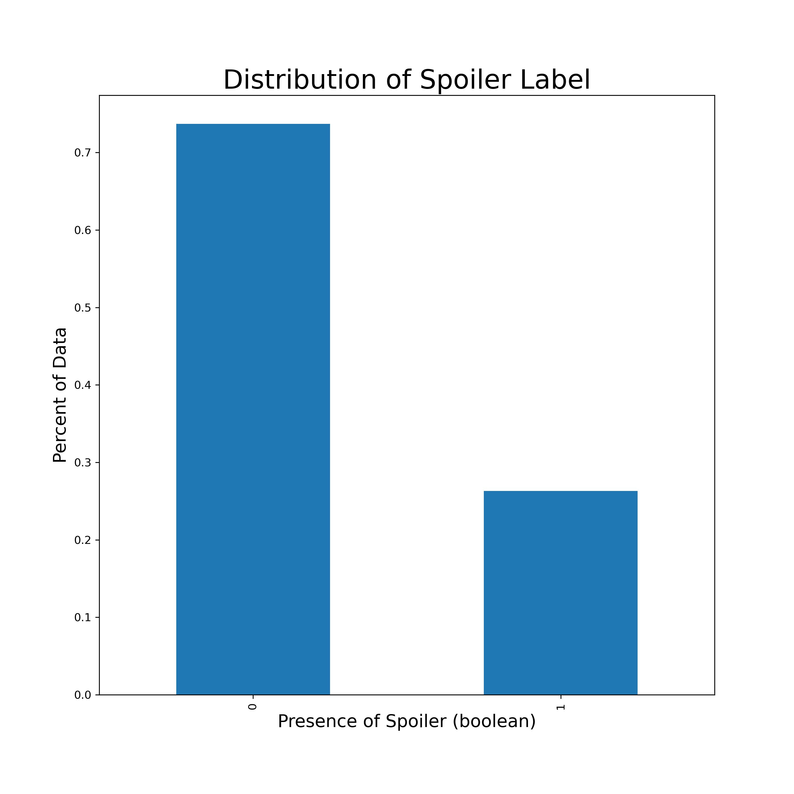
Data Understanding
Data sourced from Kaggle
573,913 reviews between 1998 and 2018
1572 unique films being reviewed
Additional film metadata and spoiler tagging
Notes:
The data is already labeled as spoiler/non
Additional film metadata includes release date, runtime, genre, film synopsis/summary
Imbalance in spoiler label, 73.7% non-spoiler (not quite 3:1 ratio)

Slide 6
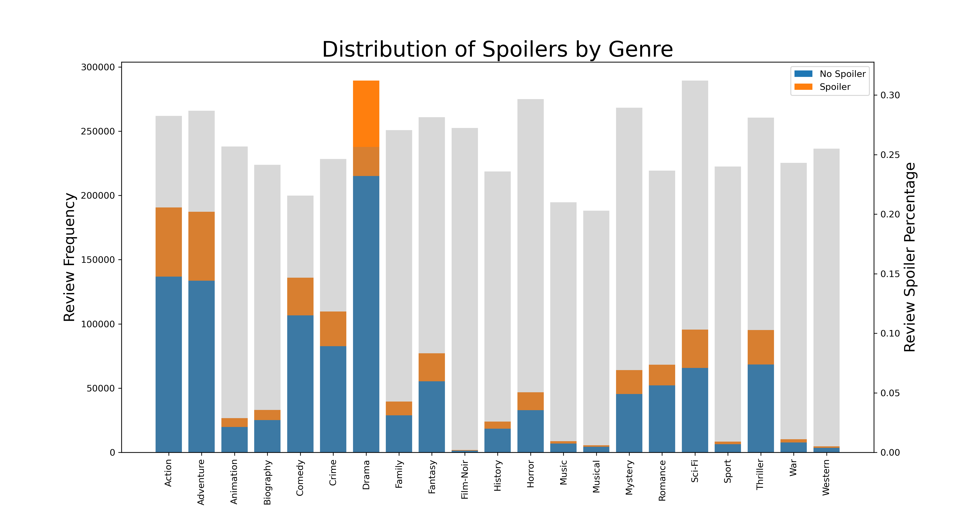
Notes:
We also investigate the distribution of reviews by genre
Here we see reviews are dominated by Drama, followed by Action and Adventure
Distribution of spoiler reviews in each genre is homogenous
All genres saw a spoiler review percentage between 20 and 31%
Highest was Sci-Fi, Horror and Mystery, Lowest were Comedy, Music and Musical
Its possible because these movies tend to have twists and surprises

Slide 7
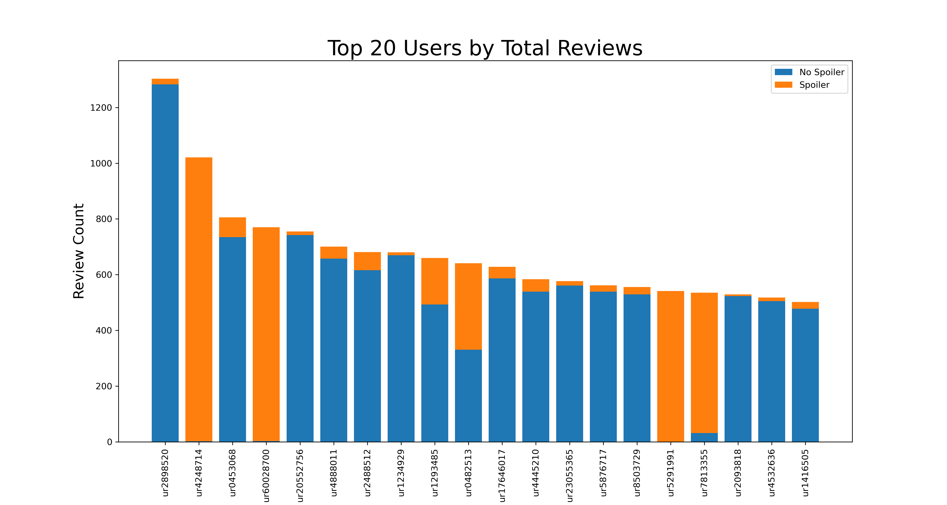
Notes:
When exploring the user_ids we discovered that most users don’t spoil at all (about 70%) and only generate 1-3 reviews.
Of the users who do spoil, most almost exclusively spoil. You can see here in the to 20 users by total number of reviews, the 2nd and 4th highest review counts are from users who left a combined 1791 reviews all but 5 of which were spoilers.
You can see also down in places 16 and 17 we have other similar users.
It would be a recommendation to IMBD to police serial offenders with impunity

Slide 8
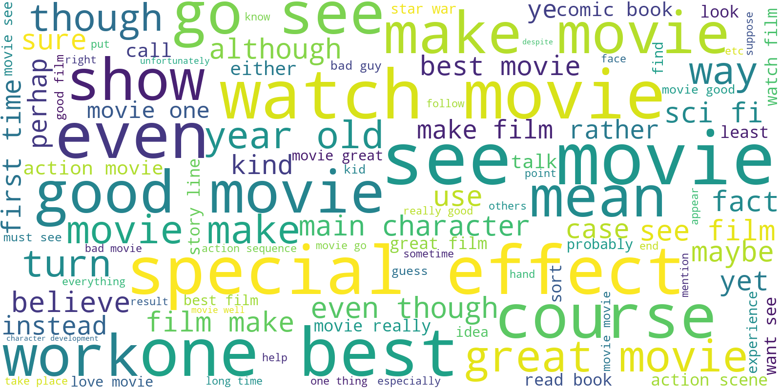
Notes:
Generated word clouds for top 100 words for non spoiler reviews and spoiler reviews
Non-spoiler word cloud:
Watch, see, special effect, great movie

Slide 9
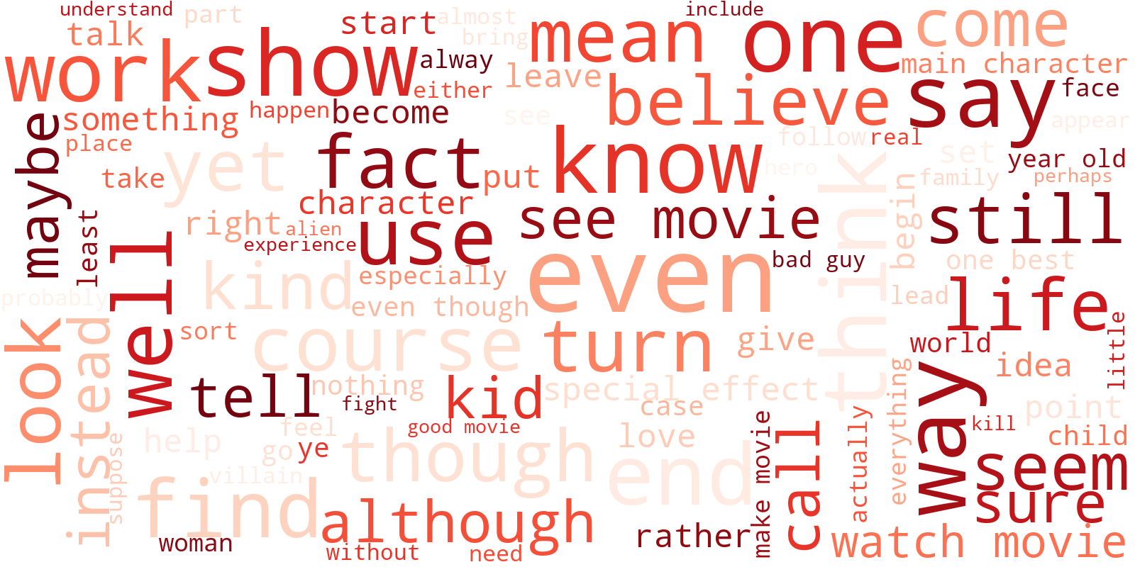
Notes:
Spoiler word cloud:
show, say, use, mean, turn, even, though, although, end

Slide 10
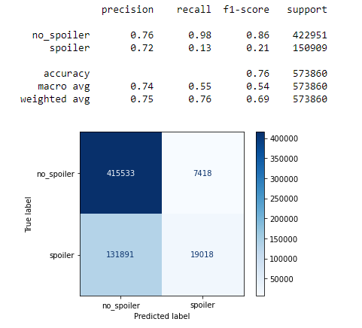
Baseline modeling
Premise: users will self-tag spoilers
Does not account for negation
Also modeled non-language features
Results in all reviews predicted as no spoiler
Notes:
We did apply this baseline model to lemmatized reviews and only used one word “spoiler”
Recall on non-spoilers was very high, but there are still reviews that use the word spoiler that aren’t
Likely something like ‘this is not a spoiler’
Does show that some users will self-censor or mark their review as spoiler, but its not reliable.
Overall accuracy not much better than if we just guessed all reviews were without spoilers
We did also model the non-language related features, but did not see any interesting results

Slide 11
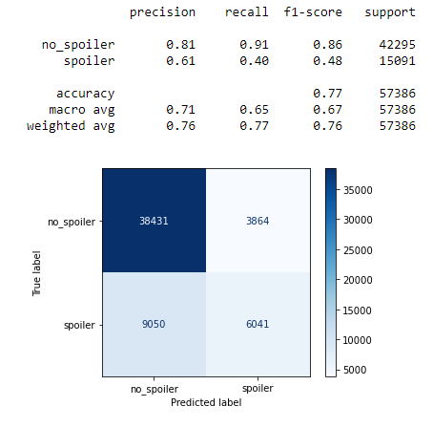
Results
Iterative testing with different encoding tools and parameters
Evaluating using f1-score and overall accuracy
Utilized several different encoding methods for bag of words modeling
Notes:
More than doubled the f1-score for spoiler detection while maintaining high recall on non-spoilers
Iterative testing showed continued, but smaller incremental, improvement
We feel like there is certainly something there that sets spoiler language apart from non, but our models are not complex enough
Bag of words loses a lot of context that new, top of the line modeling techniques use
The best model we tested used tfidf vectorizing (combining the frequency of a term in the document (review) with how common (or rare) the term is through all the reviews)
Added in bi and tri grams (2 and 3 word combinations)
Minimum occurrence 8 times

Slide 12
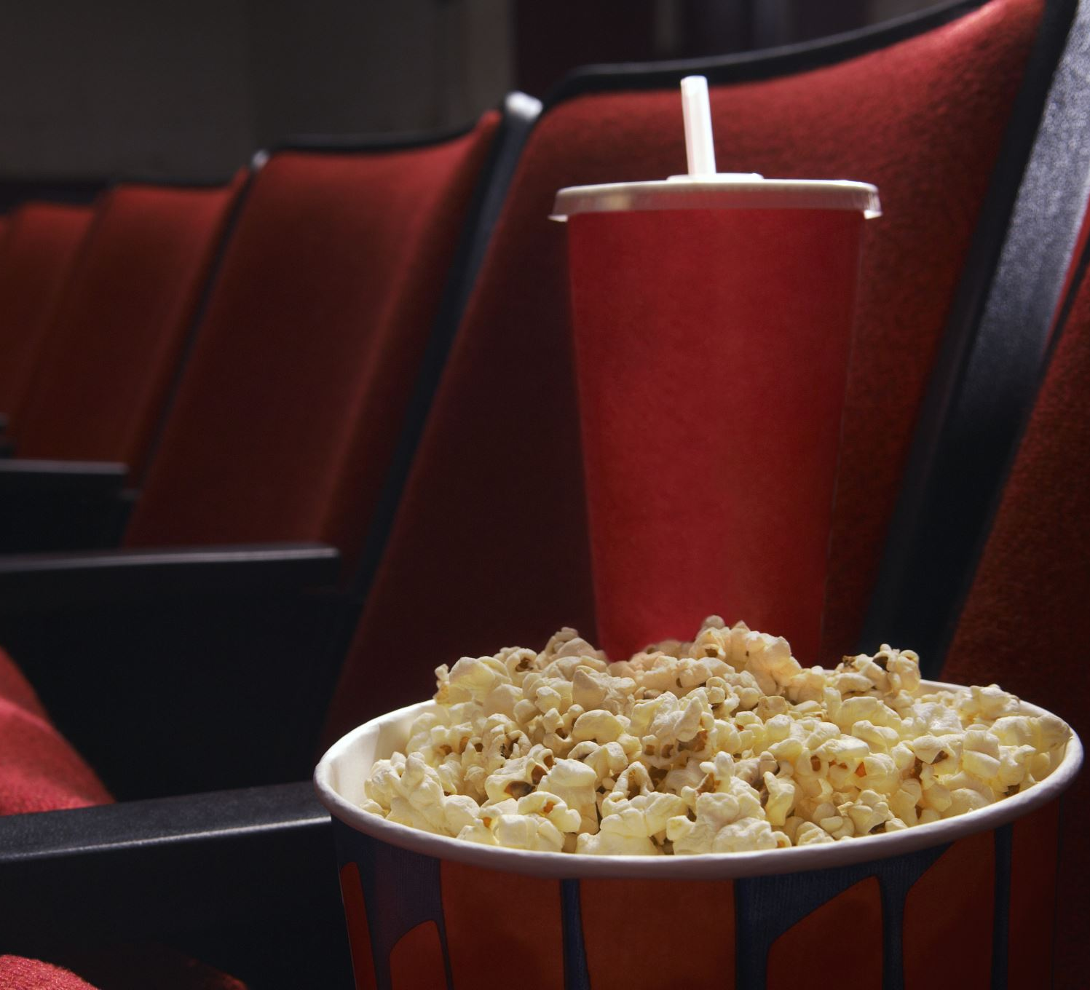
Next Steps
Scrape movie-centric subreddits
Explore cosine similarity
Use transfer learning
Notes:
Some of the largest subreddit communities are related to films and movies. The community moderators generally do a good job enforcing self-censorship when it comes to spoiler content
The tags used would identify specific text strings that contain the spoiler which can help future modeling efforts
For sites like IMDB, reviews generally occur on a page for a known film. It may be worth exploring cosine similarity between the film synopsis and the review to flag spoilers
Top of the line NLP models like BERT and roBERTa are trained on massive amount of text data and can be adapted to this problem. We attempted to implement this technique but were met with hardware and time restrictions

Slide 13
Questions?
brtracy1984@gmail.com
https://github.com/brtracy

